Slide 1

Bus Booking System Project Using Java & Mysql
A Presentation on
Presented by: Mahesh Gadhe

Slide 2




INTRODUCTION
To develop an bus booking system Using Java & Mysql to book a bus according to date.
After filling the proper details of customer we can book bus and see the status of our ticked whether it is booked or not.
This system helps customer to book a ticket without going to Bus stop or station.
Customer can enter the date and booked the ticket.

Slide 3
OBJECTIVE OF THE PROJECT:-
This project is an innovation, which makes the booking of ticket simple as compared to manual work. This project has been implemented using java and mysql.
It maintain error free records and easily incorporates the future developments and changes.
To develop as well designed interface or page to shows the details of the customers.
To help Customer to saves his time and money.

Slide 4
STRUCTURE OF PROJECT:-
Bus booking Panel :- In this design panel there are two main fields first is seat add and busbook In seat add we add seat according to date and in busbook entering that date we can book ticket.
Seat Add panel:-In this panel there are two fields first is bus no and other is date so in bus no there is bus no details and in date we can add date.
Ticket booking Panel:- In this panel when we add date it will show the table chart of bus Including status,customer name, seat,status,mobile no, date .

Slide 5
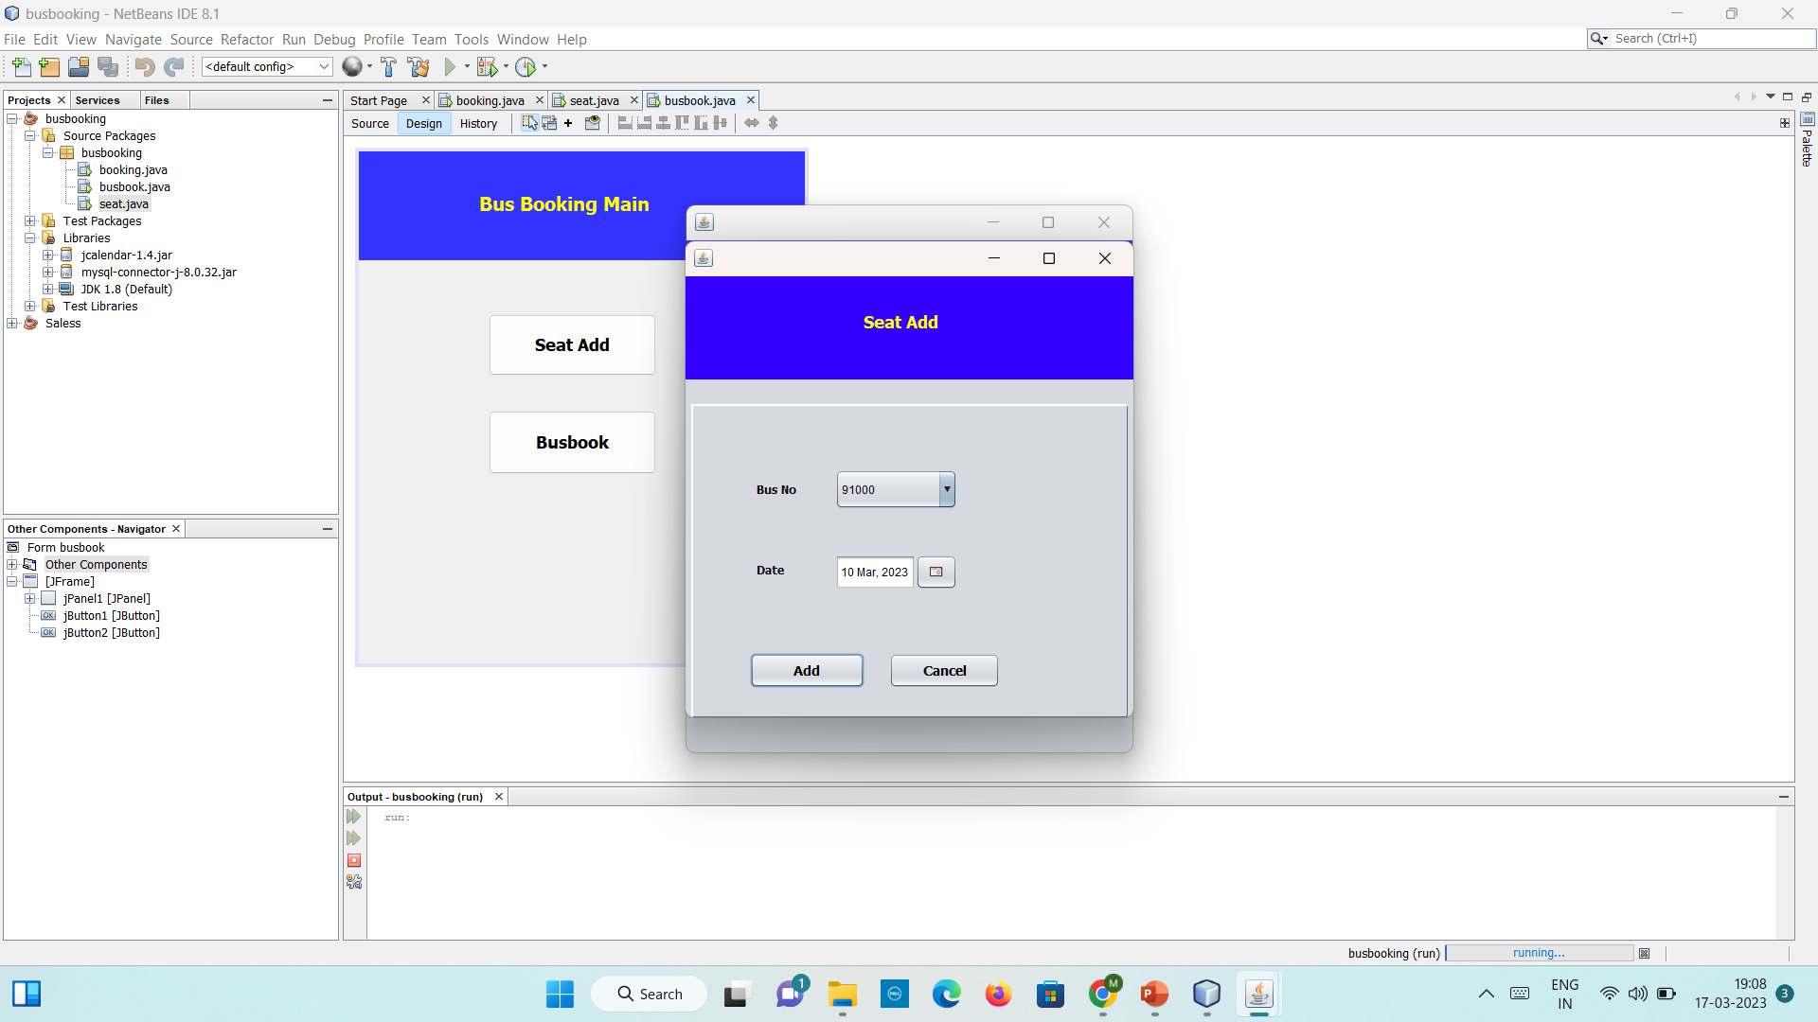
Outcome

Slide 6
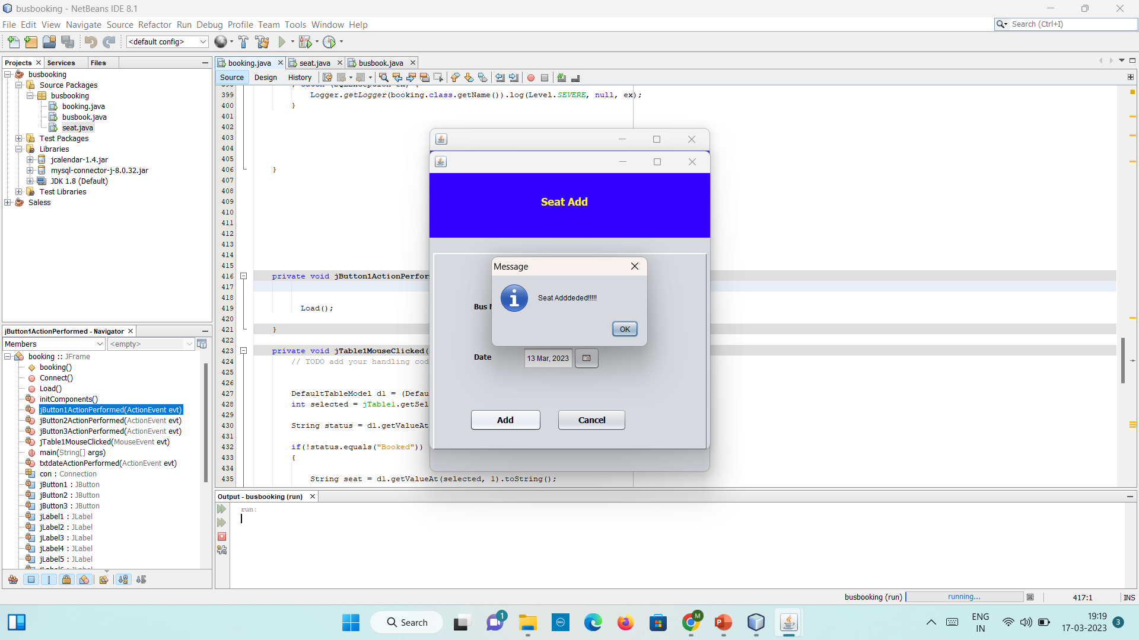

Slide 7
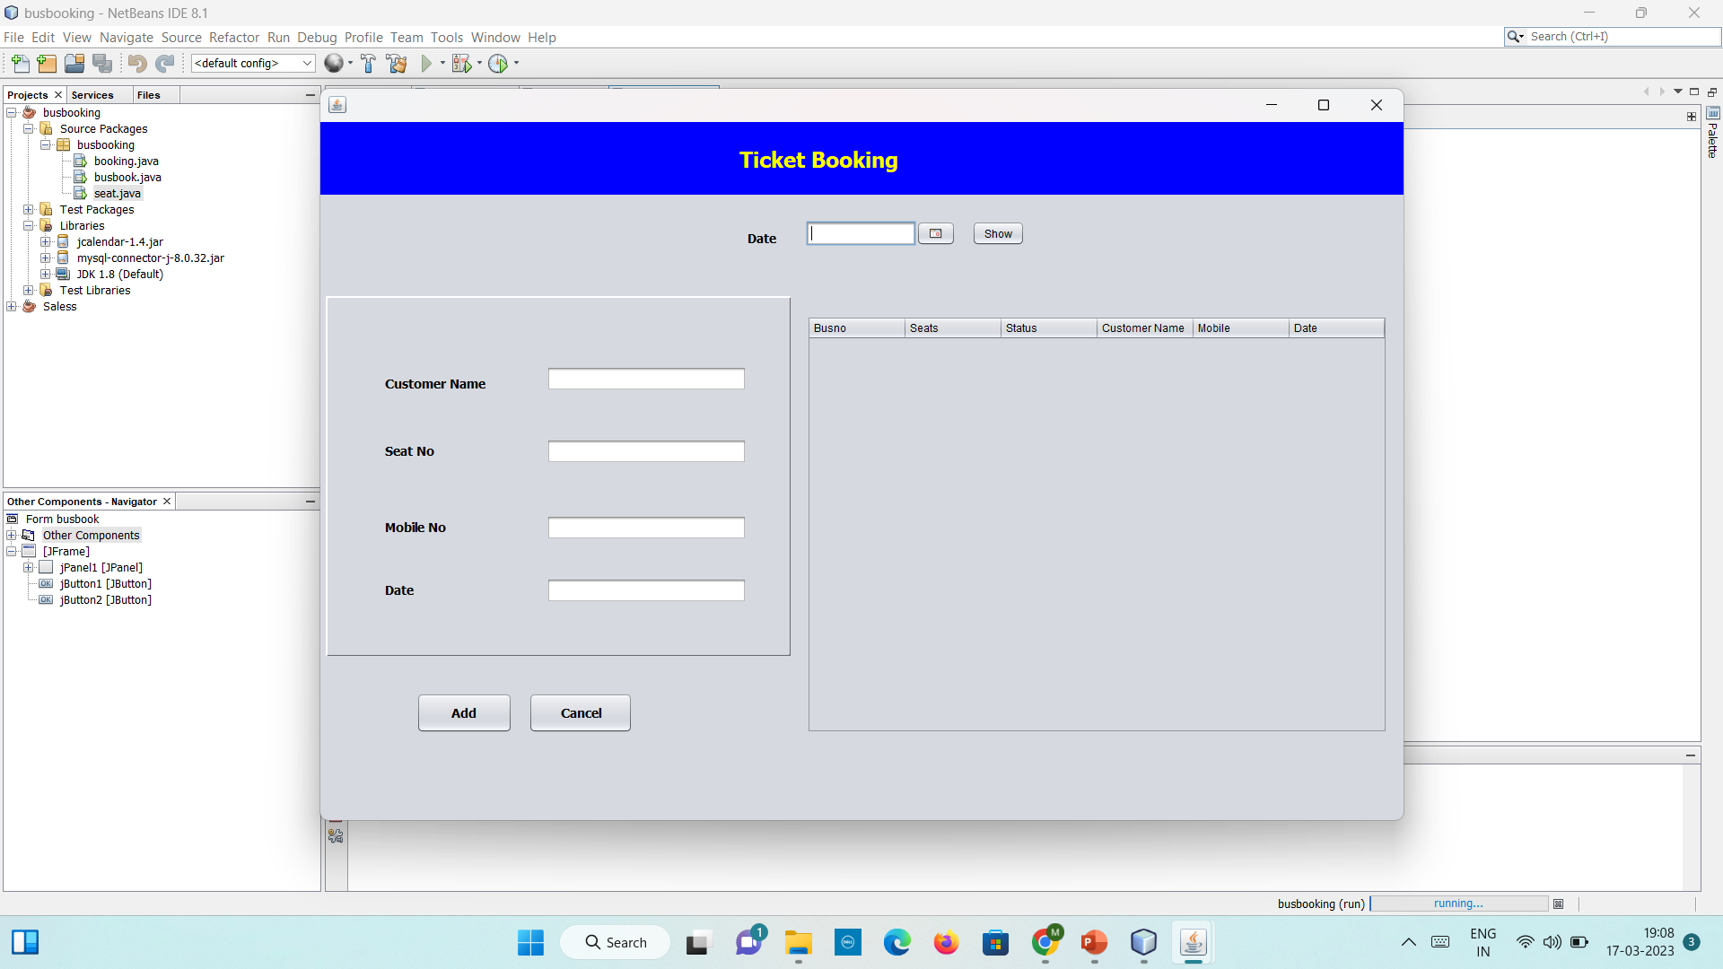

Slide 8
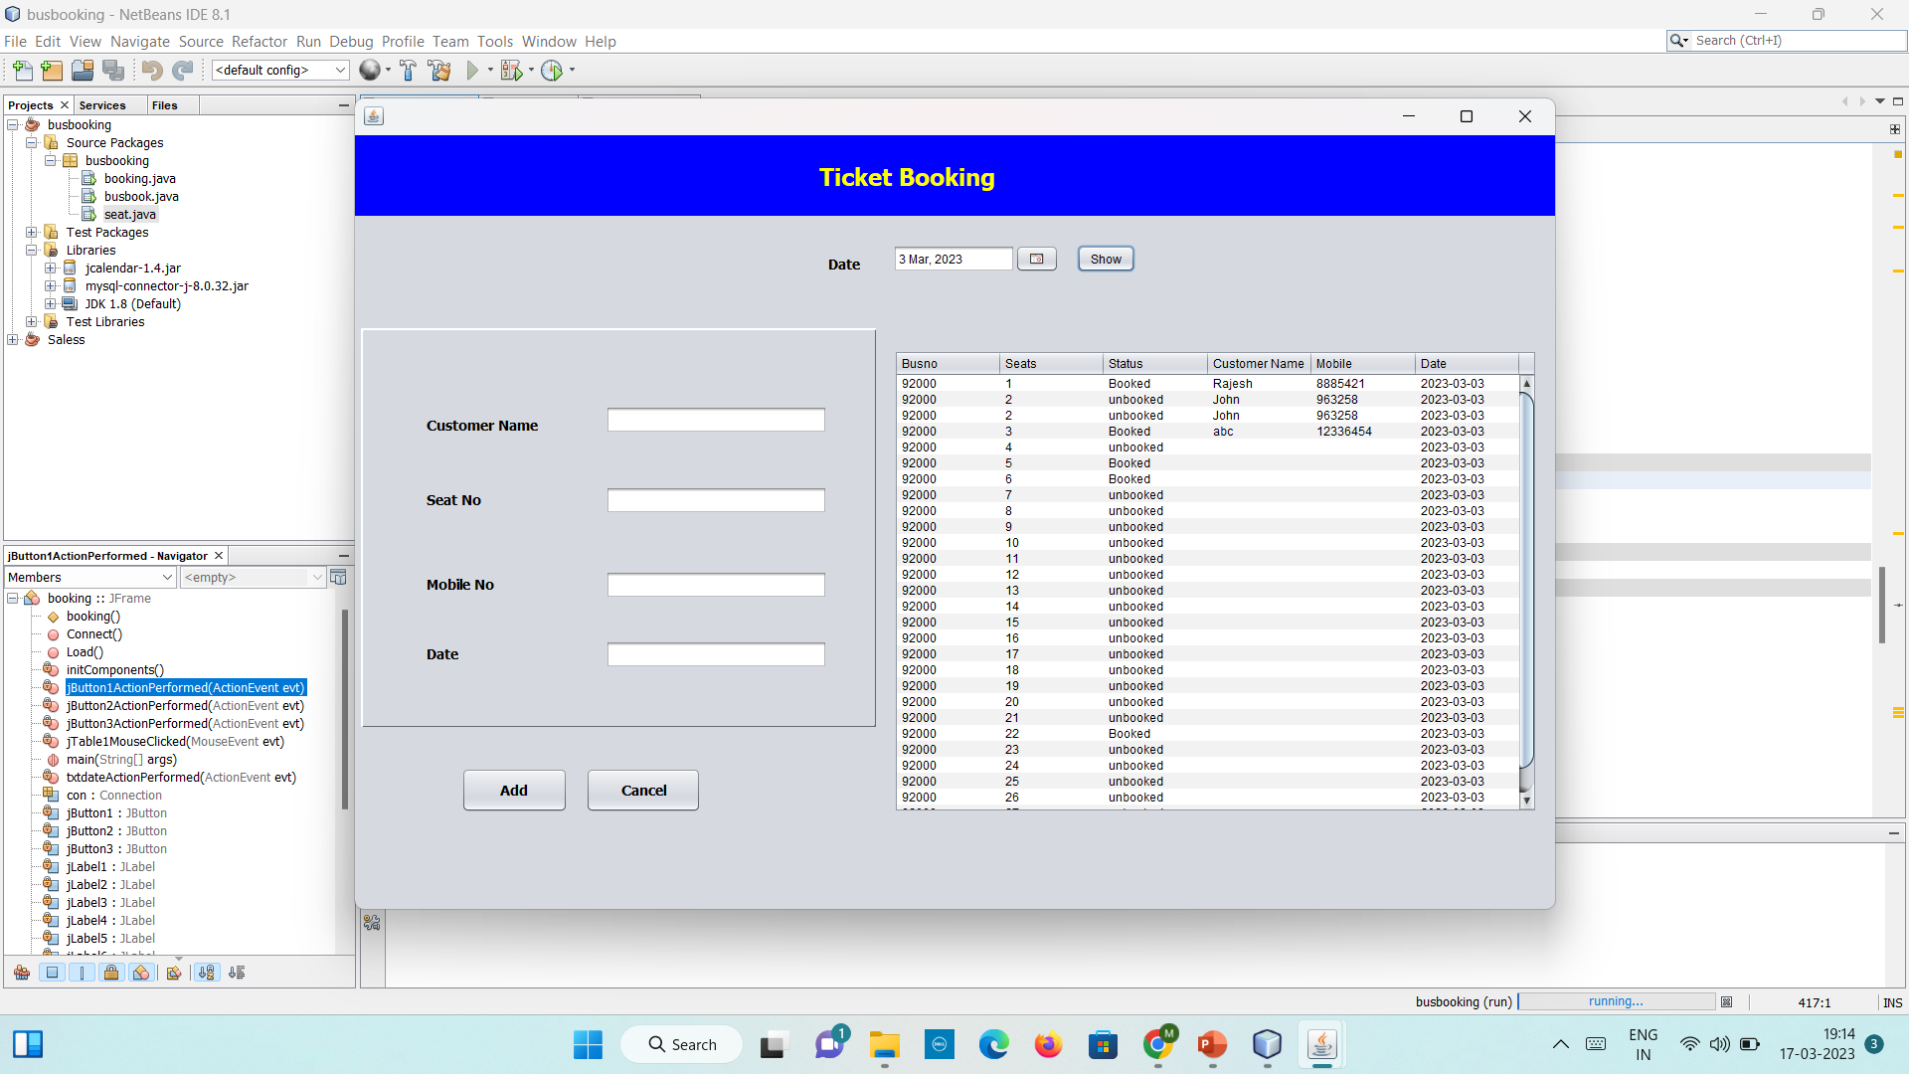

Slide 9

ADVANTAGES OF PROJECT:-
Help in maintain the Booking system and saves time of customer
Easy to use.
Flexible
Increase the efficiency.
Reduce the time

Slide 10

REQUIREMENTS OF PROJECT:-
Window 10/XP
Installed java editor
Installed java jre
Installed java jdk
Installed Net Beans
Installed Mysql workbench

Slide 11
Future Scope
Customer can saves time and money and do other work in that time.
Helps our friends ,family in future.
As any human don’t have much time so it helps customer to save time.

Slide 12


